Slide 1

Workshop on Raspberry pi

Slide 2
Course contents
1. Introduction to the PI.
2. Getting started with PI
a. Installation of NOOBS
b. Getting the PI on Gobi network
c. Installation of required libraries for python3 and basic computational libraries
3. Basic programming and compilation in Raspian with Python
4. Introduction to servo control using PI.
5. Introduction to Sense Hat and simple projects and code snippets.

Slide 3
6. Introduction to Pi camera.
7. Data transfer between PI and network servers.
Control led
Control buzzer
Control servo
Control dc motor
Control sense hat
Control picamera
8. How to Host a Server on PI

Slide 4
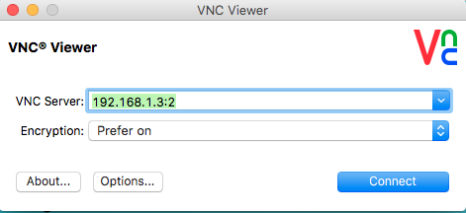
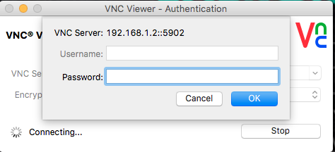
Initial setup
Install tightVNC server
For windows: http://www.tightvnc.com/download.php
Get the ip address from the respective server and enter the viewer.
PASSWORD: raspberry

Slide 5
What can a Python program do?
Like shell scripts, Python can automate tasks like batch renaming and moving large
amounts of files. Using IDLE, Python’s REPL (read, eval, print, loop) function can be used just like a command line.
However, there are more useful things you can createwith Python. Programmers use Python to create things like:
Web applications
Desktop applications and utilities
Special GUIs
Small databases
2D games

Slide 6
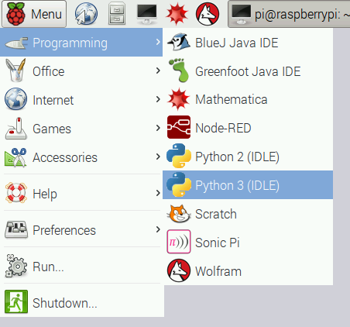
Basic coding 1.Buzzer with pwm
TightVNC viewer ~>
Menu ~>
python3 ~>
file ~>
new file~>
code ~>
F5

Slide 7
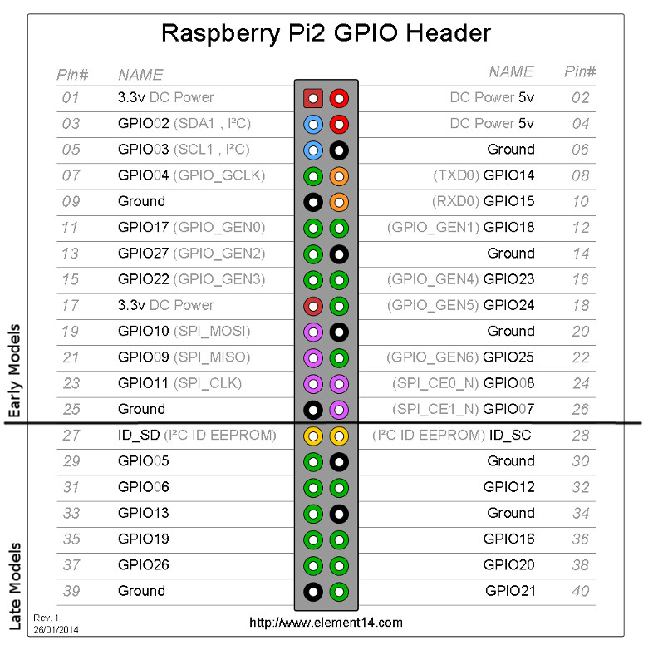
Connections on the RPi
+ve of the buzzer ---------------pin 12(board)
-ve of the buzzer-----------------pin 39(board)(GROUND)

Slide 8
Controlling Servomotor
A Servomotor, or servo, is a small device that has an output shaft. This shaft can be positioned to specific angular positions by sending the servo a coded signal.
Servos are controlled by sending an electrical pulse of variable width, or pulse width modulation (PWM), through the control wire.
There is a minimum pulse, a maximum pulse, and a repetition rate. A servo motor can usually only turn 90 degrees in either direction for a total of 180 degree movement.
The servo motor expects to see a pulse every 20 milliseconds (ms) and the length of the pulse will determine how far the motor turns.

Slide 9
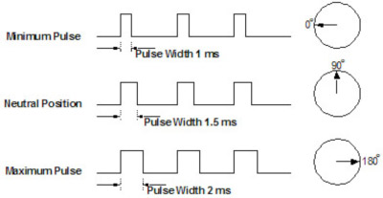
code

Slide 10
Connections to the RPi
+ve(red) to pin 2
-ve(black) to pin 39
signal(orange) to pin12

Slide 11
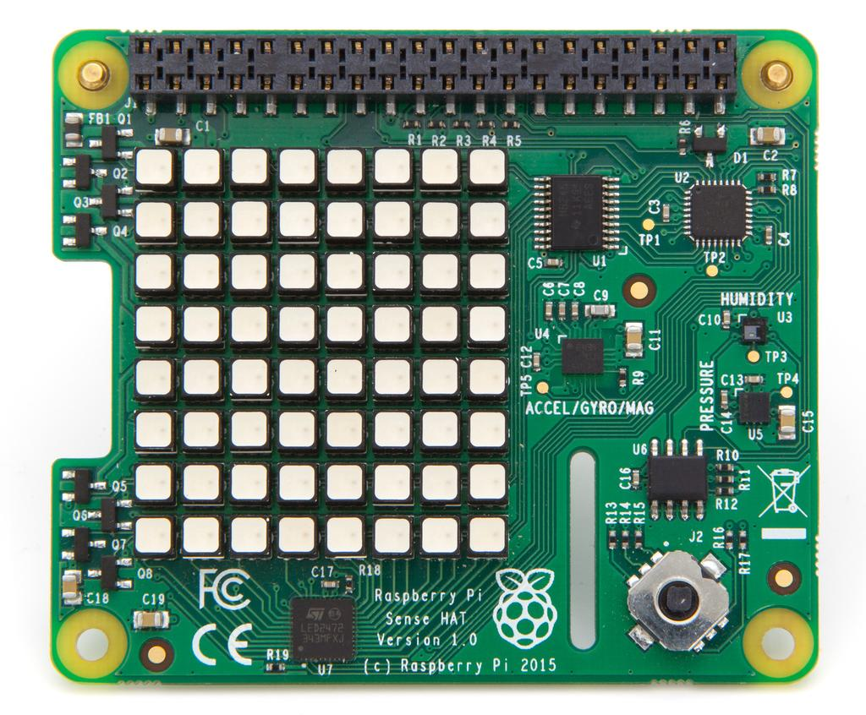
SENSE HAT
The Sense HAT is an add-on board for Raspberry Pi, made especially for the Astro Pi mission – it’s going to the International Space Station in December 2015 – and is now available to buy.
The Sense HAT has an 8×8 RGB LED matrix, a five-button joystick and includes the following sensors:
Gyroscope
Accelerometer
Magnetometer
Temperature
Barometric pressure
Humidity

Slide 12
To display message
To display temperature
To display pressure

Slide 13
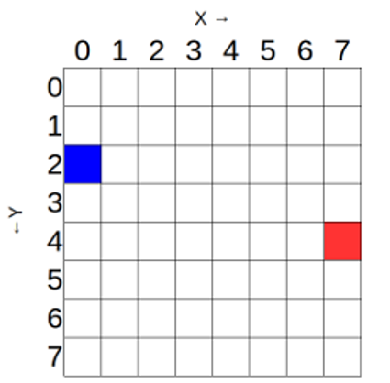
To display images
from sense_hat import SenseHat
sense = SenseHat()
sense.set_pixel(0, 2, [0, 0, 255])
sense.set_pixel(7, 4, [255, 0, 0])
code

Slide 14
Activity time!
Create any known flag using the sense hat

Slide 15
To display message
from sense_hat import SenseHat sense = SenseHat()#defining an object sense.show_message(”li2 innovations")
---------------------------------------------------------------------------------------------------------------- to control looping, speed and color from sense_hat import SenseHat sense = SenseHat() while True: #continous looping sense.show_message(”LI2 innovations“scroll_speed=0.05, text_colour=[255,255,0] , back_colour=[0,0,255])
back

Slide 16
For many PIXELS
from sense_hat import SenseHat
sense = SenseHat()
r = [255,0,0]
o = [255,127,0]
y = [255,255,0]
g = [0,255,0]
b = [0,0,255]
i = [75,0,130]
v = [159,0,255]
e = [0,0,0]
image = [ e,e,e,e,e,e,e,e,
e,e,e,r,r,e,e,e,
e,r,r,o,o,r,r,e,
r,o,o,y,y,o,o,r,
o,y,y,g,g,y,y,o,
y,g,g,b,b,g,g,y,
b,b,b,i,i,b,b,b,
b,i,i,v,v,i,i,b ]
sense.set_pixels(image)
back

Slide 17
To display the temperature
from sense_hat import SenseHat sense = SenseHat() sense.clear() tmax = 31 #max value the sensehat can display tmin = tmax - 8 # This code will display a bar that has a range of 8 degrees Celsius (one degree per horizontal row of LEDs). while True: #continous loop temp = sense.get_temperature() print(temp) temp = int(temp) - tmin for x in range(0, 8): for y in range(0, temp): sense.set_pixel(x, y, 255, 0, 0) # to display a bar that moves up and down similar to a thermometer. for y in range(temp, 8): sense.set_pixel(x, y, 0, 0, 0)
back

Slide 18
To display pressure
from sense_hat import SenseHat sense = SenseHat() sense.clear() ratio = 255 / 100.0 #255-led colour range;100-1000 to 1100 millibars, so that's 100 millibars of range. while True: #loop pressure = sense.get_pressure() pressure = round(pressure, 1) - 1000 #creating colour difference blue = int(ratio * pressure) if blue > 255: blue = 255 sense.clear((0, 0, blue))
back

Slide 19
Thank you!

Slide 20
DAY 2

Slide 21
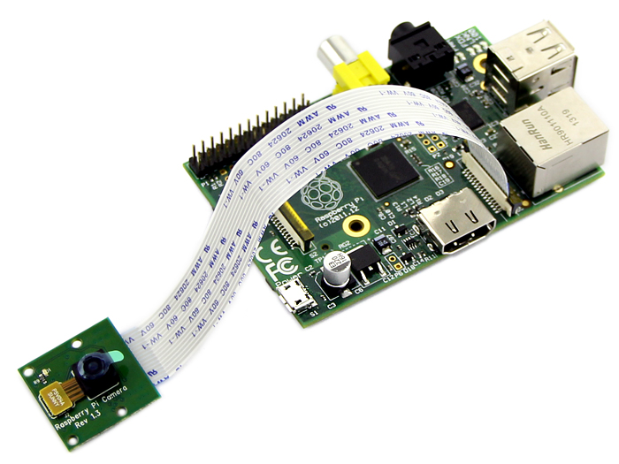
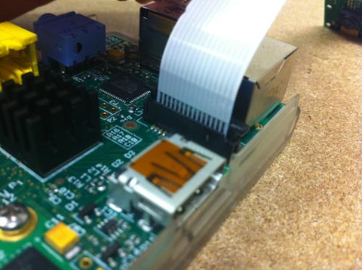
Pi Camera
Connections:
Specifications:
Small board size: 25mm x 20mm x 9mm.
A 5MP (2592×1944 pixels) Omnivision 5647 sensor in a fixed focus module.
Support 1080p30, 720p60 and 640x480p60/90 video record.

Slide 22
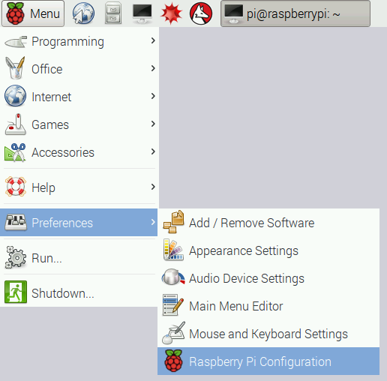
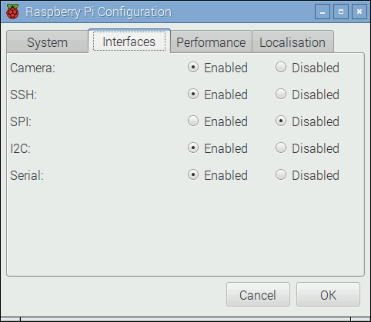
setup
Note: If it's not enabled, enable it
and reboot your Pi to begin

Slide 23
code
from picamera import PiCamera from time import sleep camera = PiCamera() #define object camera.start_preview()#stsrt the cam sleep(10) #pause camera.stop_preview()#stop the cam
Note: Open a new file and save it as camera.py. It's important that you do not save it as picamera.py.

Slide 24
Effects
camera.start_preview()
camera.annotate_background = Color('blue')
camera.annotate_foreground = Color('yellow')
camera.annotate_text = " Hello world "
sleep(5)
camera.stop_preview()
back

Slide 25
To take still pics!
camera.capture('/home/pi/Desktop/image.jpg')
note:t's important to sleep for at least 2 seconds before capturing, to give the sensor time to set its light levels.
You'll see your photo on the Desktop. Double-click the file icon to open it:
Now try adding a loop to take five pictures in a row

Slide 26
Activity time!
Try to take five pictures in a row!!

Slide 27
Recording video
Adding effects
Use of filters

Slide 28
Steps to Live streaming
Install build dependencies The following command installs the three libraries that MJPG-Streamer uses: $ sudo apt-get install libjpeg8-dev imagemagick libv4l-dev
2. Add missing videodev.h The videodev.h header file that MJPG-Streamer needs has been replaced with a videodev2.h. $ sudo ln -s /usr/include/linux/videodev2.h /usr/include/linux/videodev.h
3. Download MJPG-Streamer The source code for MJPG-Streamer is available at sourceforge.net, but it is tricky to find the direct download link: $ wget http://sourceforge.net/code-snapshots/svn/m/mj/mjpg-streamer/code/mjpg-streamer-code-182.zip

Slide 29
4. Unzip the MJPG-Streamer source code
The source code download is a compressed zip file. $ unzip mjpg-streamer-code-182.zip
5. Build MJPG-Streamer
MJPG-Streamer comes with several plugins, but only a couple of them are needed to stream the video
$ cd mjpg-streamer-code-182/mjpg-streamer
$ make mjpg_streamer input_file.so output_http.so
6. Install MJPG-Streamer
$ sudo cp mjpg_streamer /usr/local/bin
$ sudo cp output_http.so input_file.so /usr/local/lib/
$ sudo cp -R www /usr/local/www
7. Start the camera
$ mkdir /tmp/stream
8. Creat a Bash script to run the camera.
$ sudo nano streamstart.sh

Slide 30
-INCLUDE THESE COMMANDS IN THE SCRIPT
raspistill --nopreview -w 640 -h 480 -q 5 -o /tmp/stream/pic.jpg -tl 100 -t 9999999 -th 0:0:0 &
LD_LIBRARY_PATH=/usr/local/lib mjpg_streamer -i "input_file.so -f /tmp/stream -n pic.jpg" -o "output_http.so -w /usr/local/www"
-save and quit
9. Run the script as:
$sudo bash streamstart.sh
10) To view the stream, Type :
http://<YOUR PI's IP>:8080/?action=stream

Slide 31
Recording a video
camera.start_preview()
camera.start_recording('/home/pi/video.h264')
sleep(10)
camera.stop_recording()
camera.stop_preview()
back

Slide 32
How to Host a Server on PI

Slide 33
Web Server
A web server is a computer system that processes requests via HTTP, the basic network protocol used to distribute information on the World Wide Web.
A user agent, commonly a web browser or web crawler, initiates communication by making a request for a specific resource using HTTP and the server responds with the content of that resource or an error message if unable to do so.

Slide 34

Apache is a freely available Web server that is distributed under an “open source” license. There are actually two “apache” web servers. Apache is shorthand for the Apache Software Foundation which is one of the largest if not the largest free and open source software organizations.
Why Apache
- A very long history of reliability and performance.
- Mass adoption means there is a LOT of documentation out there and it is very easy to get help with any trouble you might run in to.
- It is free and commercial friendly
- no licensing fees or costs.
- It will run on pretty much any OS (Linux, Windows and MacOS)
- It is actively maintained.
- It is one of the most feature rich web servers available.

Slide 35
Creating Raspberry Pi Web Server using PHP
1. First we will need install the apache 2 package: sudo apt-get install apache2 -y2 To check that it is working we should be able to enter the Pi’s IP address. If you don’t know the IP you can enter the following line hostname –I 3. Browse to the IP address in a browser and we should be able to get the default page. 4. Now you’re able to edit this basic file by simply entering the following command. sudo nano /var/www/index.html 5. You can now add as many new webpages as you want in the www folder and they will be viewable from the browser. 6. This is a very basic server and is great if you just want to learn HTML, JS or CSS but if you’re after PHP then read on. 7. To install PHP we will need to first get the PHP package so download the PHP5 module for apache. To do this enter the following : sudo apt-get install php5 libapache2-mod- php5 –y 8. Now we can place php files in the www and they will be processed and displayed. For an example let’s make a file called example.php 9. In this file add the following: <?php echo “applied materials” ?> we have a fully working Apache2 + PHP Raspberry Pi Web Server working. Now you’re able to have mix of HTML and PHP files all in the www folder

Slide 36
Data transfer between PI and network servers.
CONTROLLING AN LED
-Give privileges to www actions on you raspberry pi by editing the following file $ sudo nano /etc/sudoers
Insert the following text on the www-data ALL=(ALL) NOPASSWD:ALL
-Create you sample Web-Page in /var/www/html/ directory. -sudo nano led.php- ‘type in your sample code’

Slide 37
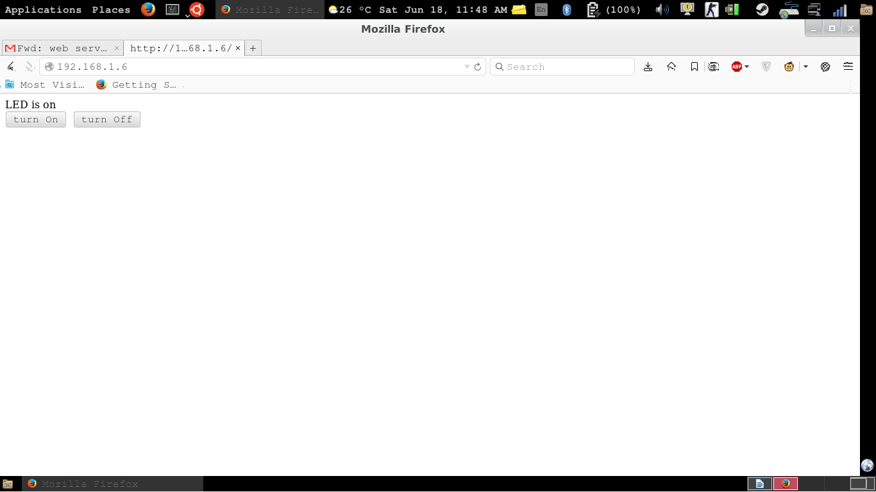


Slide 38
HTML PAGE
CONTINUED:
if (isset($_POST['OFF']))
{
exec("sudo python /home/ledoff.py");
echo "LED is OFF";
}
?>
<form method="post">
<button name="ON">turn On</button>&nbsp;
<button name="OFF">turn Off</button><br>
</form>
</html>
<html>
<head>
<meta charset="UTF-8" />
</head>
<?php
if (isset($_POST['ON']))
{
exec("sudo python /home/ledon.py");
echo "LED is on";
}
BACK

Slide 39
//buzzer pwm
import time import RPi.GPIO as GPIO GPIO.setmode(GPIO.BOARD)#choose bw board and bcm GPIO.setup(12, GPIO.OUT)#set pin 12 as output p = GPIO.PWM(12, 50) # channel=12 frequency=50Hz p.start(0) try: while 1: for dc in range(0, 101, 5): p.ChangeDutyCycle(dc)#sets the duty bw the dc range time.sleep(1)#pause for dc in range(100, -1, -5): p.ChangeDutyCycle(dc) time.sleep(1) except KeyboardInterrupt: pass p.stop() GPIO.cleanup()
back

Slide 40
//servomotor
import RPi.GPIO as GPIO
import time
GPIO.setmode(GPIO.BOARD)
GPIO.setup(12, GPIO.OUT)
p = GPIO.PWM(12, 50)
p.start(7.5)
try:
while True:
p.ChangeDutyCycle(7.5) # turn towards 90 degree
time.sleep(1) # sleep 1 second
p.ChangeDutyCycle(2.5) # turn towards 0 degree
time.sleep(1) # sleep 1 second
p.ChangeDutyCycle(12.5) # turn towards 180 degree
time.sleep(1) # sleep 1 second
except KeyboardInterrupt:
p.stop()
GPIO.cleanup()
back

Slide 41
Add filters
camera.start_preview()
camera.image_effect = 'colorswap'
sleep(5)
camera.capture('/home/pi/Desktop/colorswap.jpg')
camera.stop_preview()
back

Slide 42
Pi Face

Slide 43
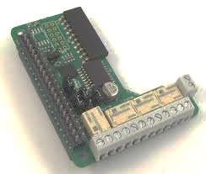
Introduction
Features:
● 2 Dual­H­Bridge motor drivers, allowing you to drive 4 DC motors ● Raspberry Pi® HAT footprint when used with PiFaceTM Relay+ ● Easy connection with screw terminals ● Compact size ● Can be used directly in breadboards, prototyping and custom designs
Technical specifications: ● Motor power supply voltage 0V to 11V ● Device power supply voltage 2V to 7V ● 4 changeover relays, 20V 1A switching max ● Operating Temp ­40° to 70° ● Standard 0.1” pin spacing (breadboard & veroboard compatible)

Slide 44
LED
DC motor

Slide 45
On/off LED
Import the Relay+ module and the time module (which you will use for delays) with the following lines:
import pifacerelayplus import timeNow #initialise your Relay+. pfr = pifacerelayplus.PiFaceRelayPlus(pifacerelayplus.RELAY)#In this line the pifacerelayplus.RELAY refers to any PiFaceTM EXTRA board you have attached. pfr.relays[0].toggle() #Then toggle (bw off and on) the first relay time.sleep(2)#pause to see the result pfr.relays[0].toggle()#toggle it again
back

Slide 46
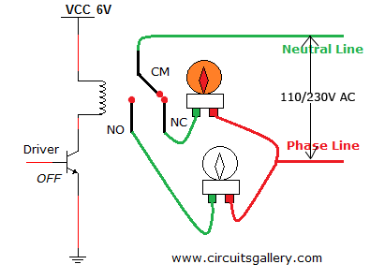
Circuit Diagram

Slide 47
DC motor
import pifacerelayplus import time pfr = pifacerelayplus.PiFaceRelayPlus(pifacerelayplus.RELAY)#In this line the pifacerelayplus.RELAY refers to any PiFaceTM EXTRA board you have attached.
While(True): pfr.relays[0].toggle() #Then toggle (bw off and on) the first relay time.sleep(2)#pause to see the result pfr.relays[0].toggle()#toggle it again
time.sleep(2)

Slide 48
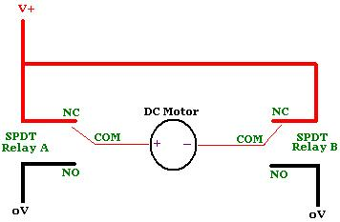
Circuit Diagram

